Slide 1

Building Neural Networks for Deep Learning Application
Hao Ji, Data Scientist
USC Center for Advanced Research Computing

Slide 2
Introduction
Neural Networks
Applications
PyTorch
Summary
Content
Introduction
Section 1: Introduction to Deep Learning
Section 2: Basics of Neural Networks
Neural Networks
Applications
Section 3: Deep Learning Applications
PyTorch
Section 4: Building Neural Networks with PyTorch
Summary
Section 5: Summary

Slide 3

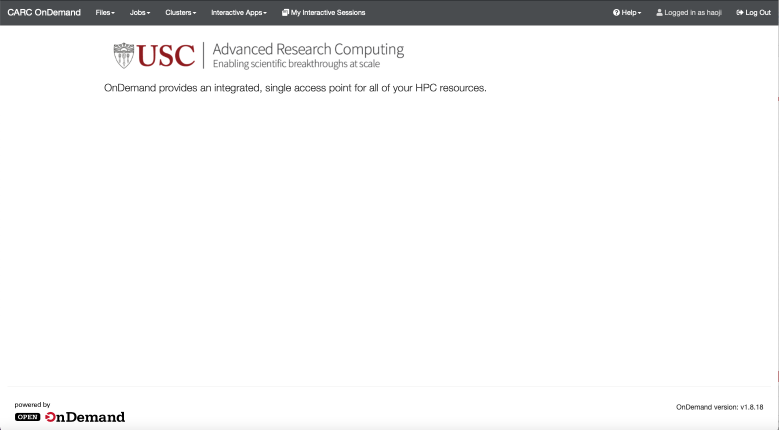
Introduction
Neural Networks
Applications
PyTorch
Summary
CARC OnDemand
Web Address: https://carc-ondemand.usc.edu

Slide 4
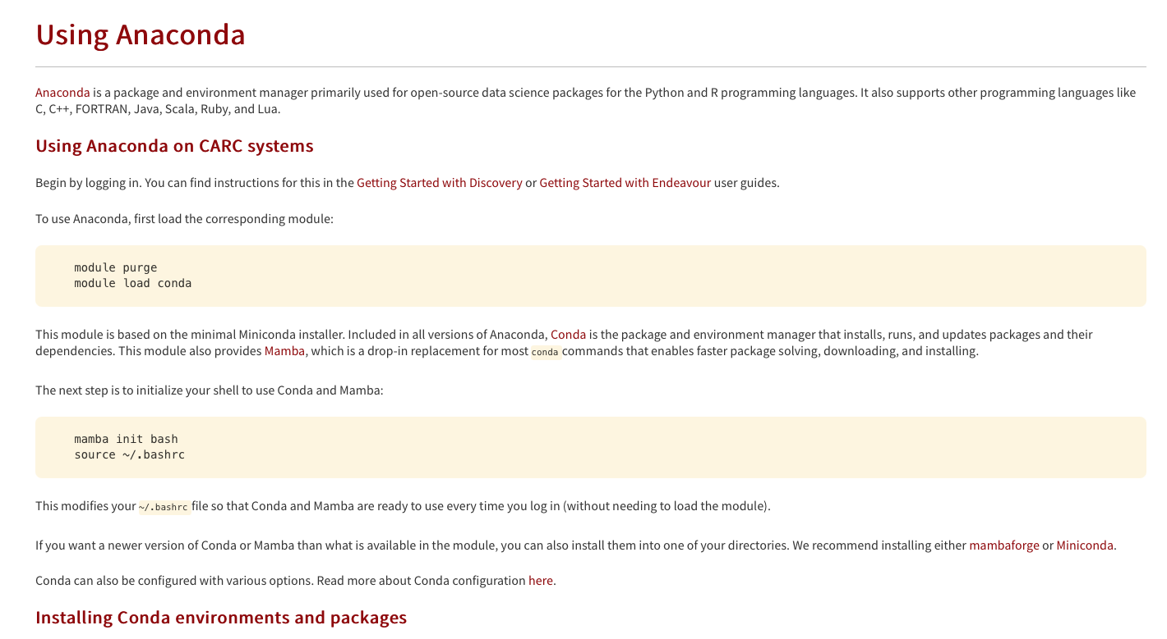
Introduction
Neural Networks
Applications
PyTorch
Summary
Using Anaconda on CARC
Anaconda: package and environment manager primarily used for open-source data science packages for the Python and R programming languages.
https://www.carc.usc.edu/user-information/user-guides/software-and-programming/anaconda

Slide 5
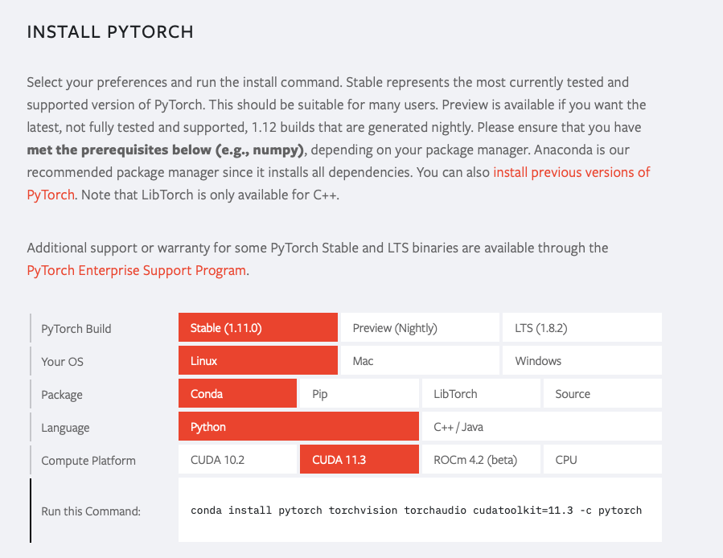
Introduction
Neural Networks
Applications
PyTorch
Summary
Using Anaconda on CARC
https://pytorch.org

Slide 6
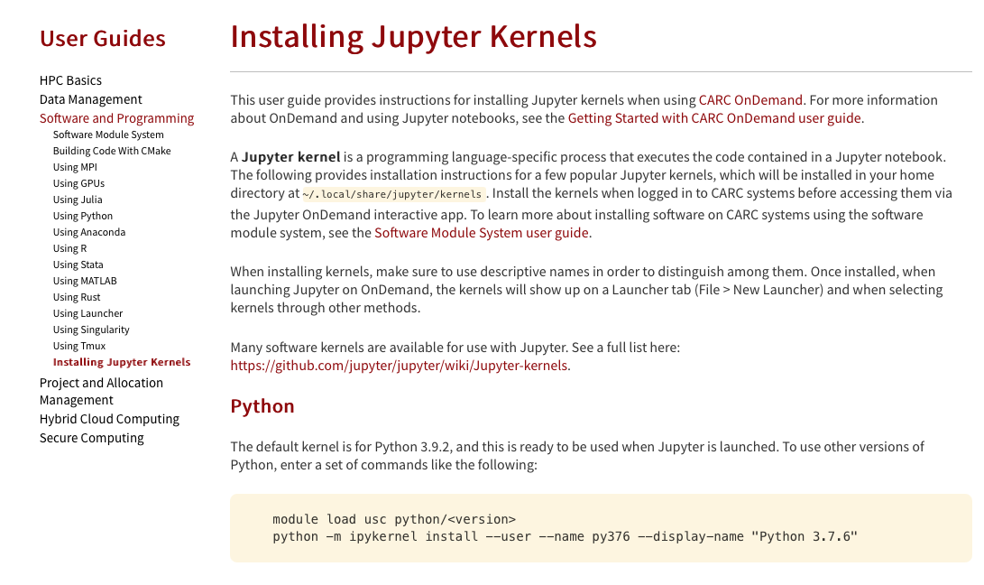
Introduction
Neural Networks
Applications
PyTorch
Summary
Creating Jupyter Kernel
A Jupyter kernel is a programming language-specific process that executes the code contained in a Jupyter notebook.
https://www.carc.usc.edu/user-information/user-guides/software-and-programming/jupyter-kernels

Slide 7
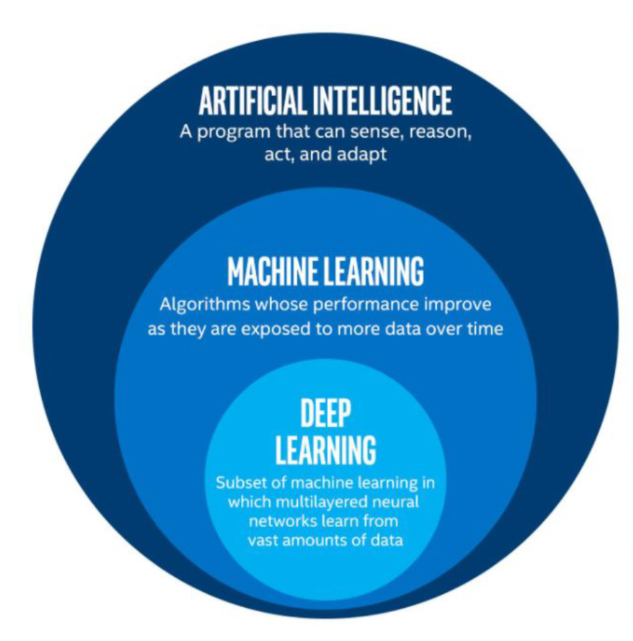
Introduction
Neural Networks
Applications
PyTorch
Summary
Introduction to Deep Learning
Deep Learning: subfield of traditional machine learning
Inspired by the structure and function of the brain: Artificial Neural Networks
Computer vision: Tesla recognizing items on a street
Text Generation: An algorithm trained to create a new Shakespeare piece
Speech recognition
Computer Games: AlphaGo

Slide 8
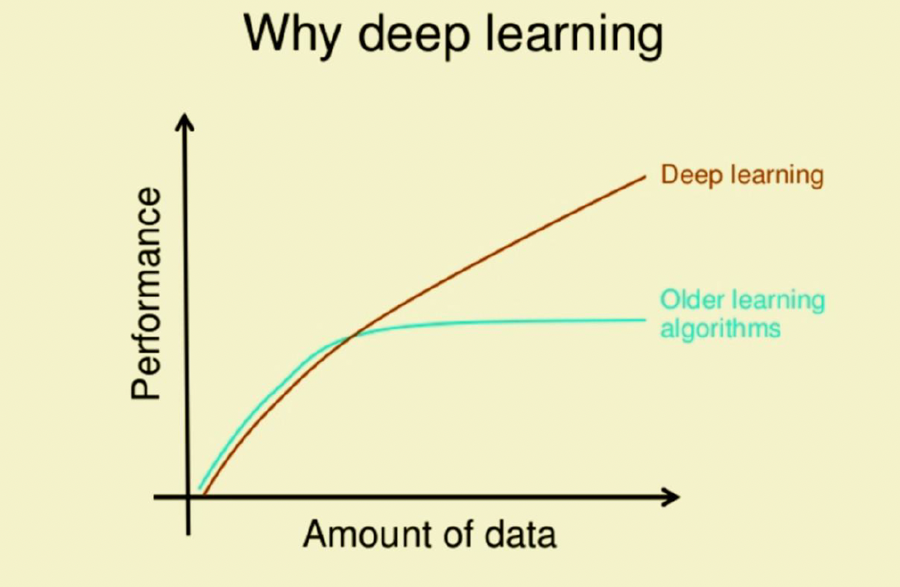
Introduction
Neural Networks
Applications
PyTorch
Summary
Introduction to Deep Learning
Why Deep Learning so hot recently?
Performs better with larger amounts of data
Requires strong computation units such as GPU’s
Data Storage

Slide 9
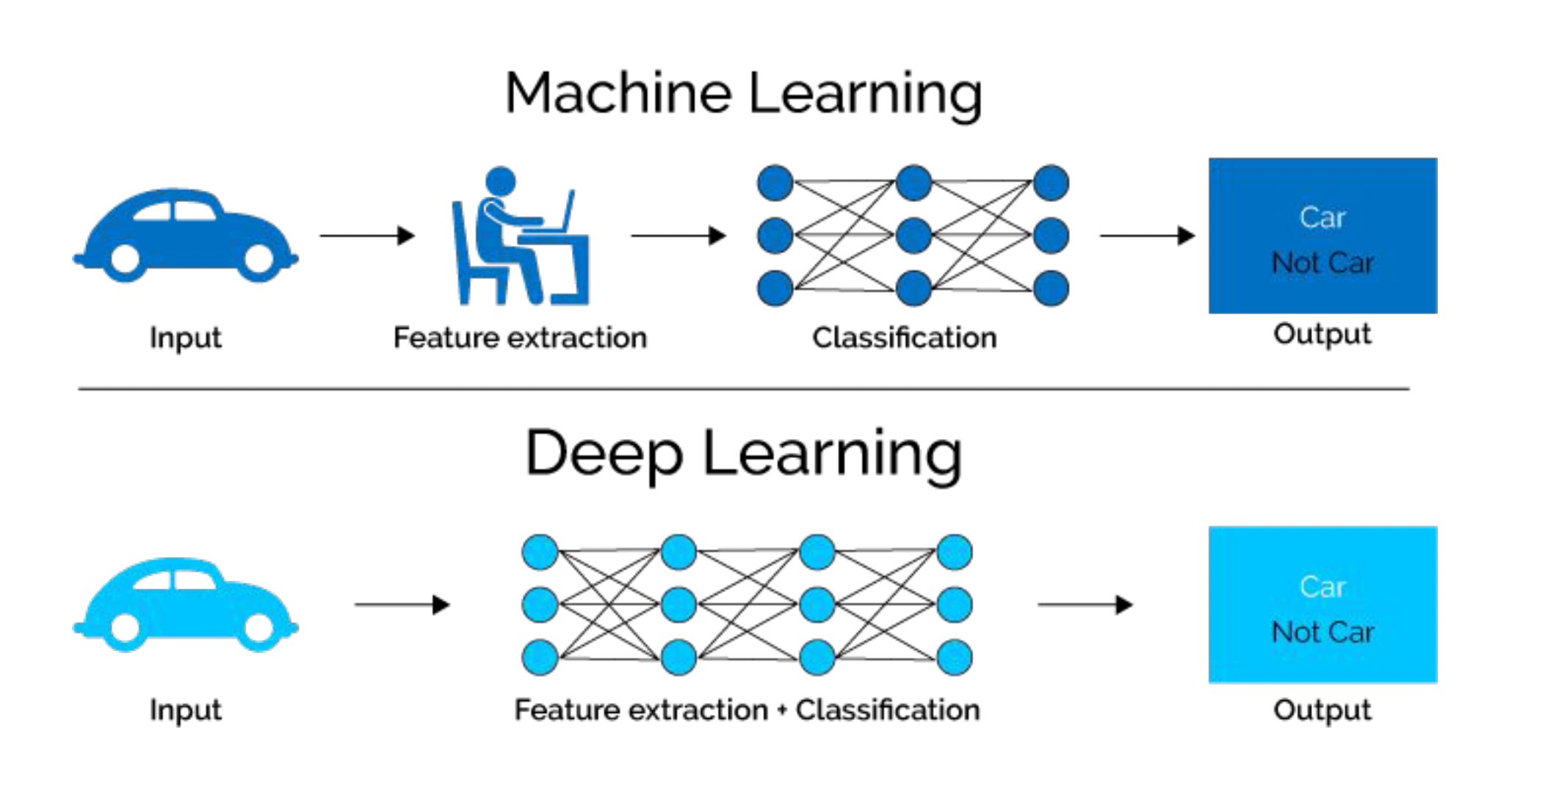
Introduction
Neural Networks
Applications
PyTorch
Summary
Introduction to Deep Learning

Slide 10
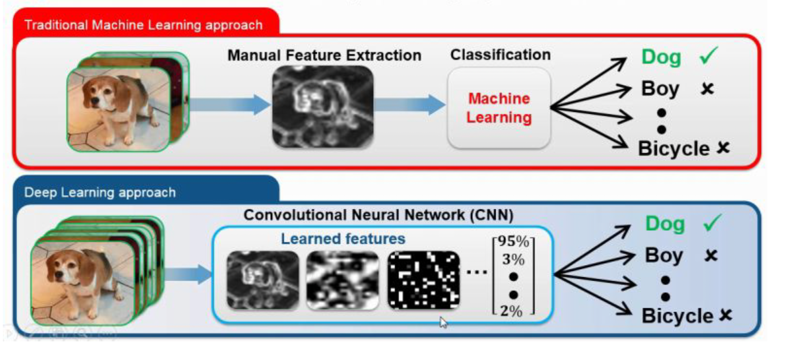
Introduction
Neural Networks
Applications
PyTorch
Summary
Introduction to Deep Learning
Deep Learning is a machine learning technique that can learn useful representations or features directly from images, text and sound

Slide 11
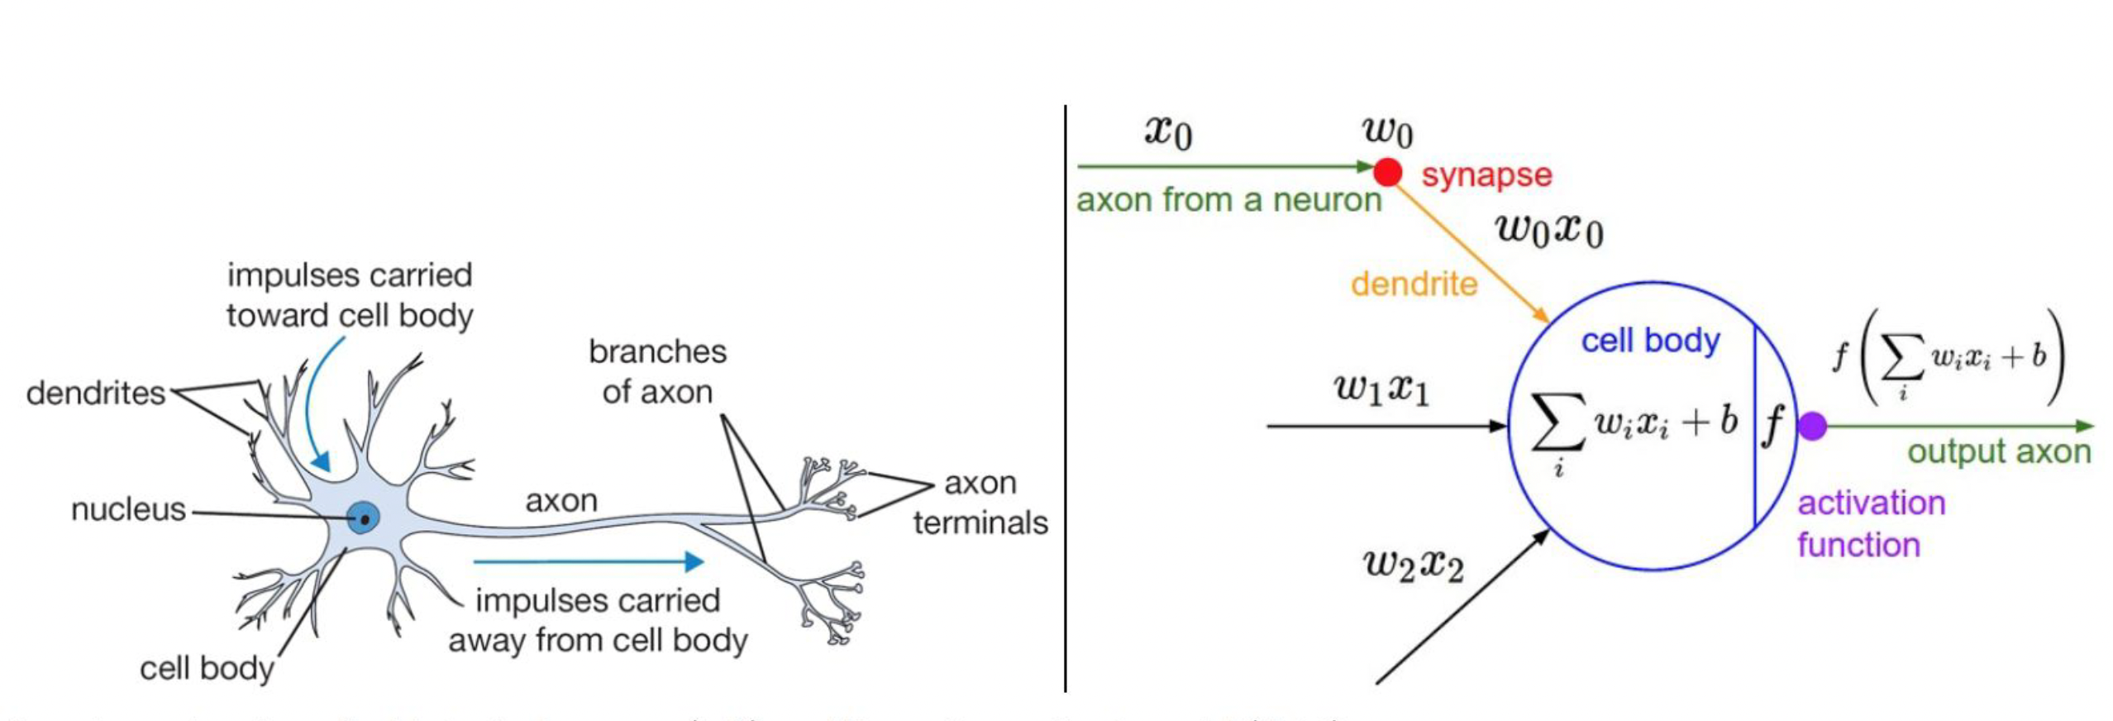
Introduction
Neural Networks
Applications
PyTorch
Summary
Neural Networks
biological neuron
artificial neural networks

Slide 12
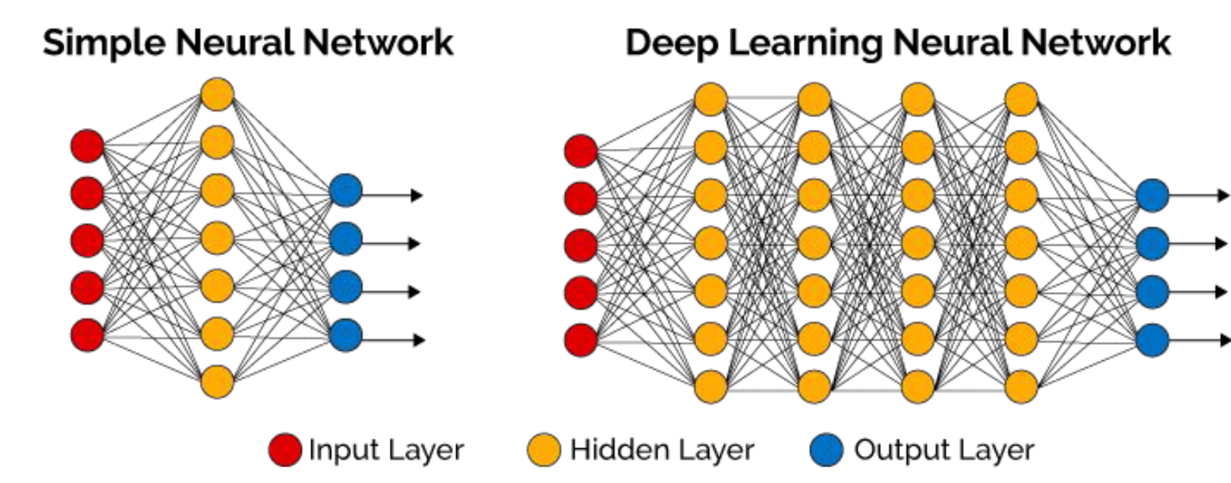
Introduction
Neural Networks
Applications
PyTorch
Summary
Neural Networks
Deep neural networks (DNN) usually has more hidden layers
Still has same 3 types of layers
A neural network (NN) has 3 types of layers:
Input layer Hidden layer Output layer

Slide 13

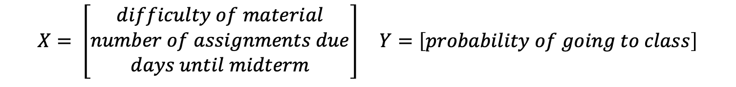
Introduction
Neural Networks
Applications
PyTorch
Summary
Building Neural Networks
Task: Predict if it worth going to class or not
$$X= \left[\begin{aligned}difficulty of material \\ number of assignments due \\ days until midterm\end{aligned}\right] Y=\left[probability of going to class\right]$$

Slide 14

Introduction
Neural Networks
Applications
PyTorch
Summary
Building Neural Networks
Task: Predict if it worth going to class or not
$$X= \left[\begin{aligned}difficulty of material \\ number of assignments due \\ days until midterm\end{aligned}\right]$$
$$Y=\left[probability of going to class\right]$$

Slide 15
Introduction
Neural Networks
Applications
PyTorch
Summary
Neural Networks
Three steps to training a neural network
1 Forward propagation: push example through the network to get a predicted output
2 Compute the cost: calculate the difference between predicted output and actual data
3 Backward propagation: push back the derivative of the error and apply to each weight, such that next time it will result in a lower error

Slide 16
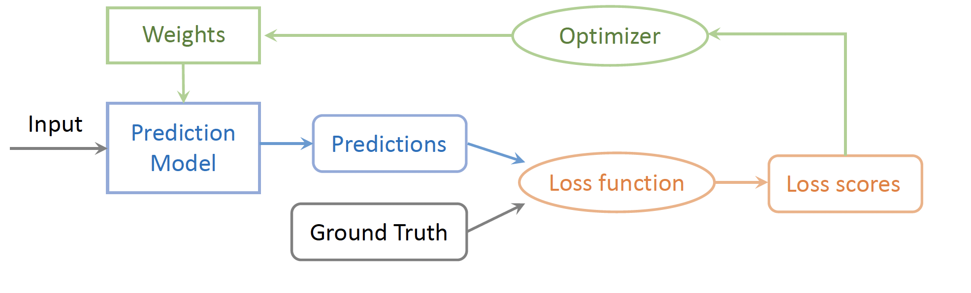
Introduction
Neural Networks
Applications
PyTorch
Summary
Training Pipeline
The training pipeline consists of choosing the prediction model, the loss function and the optimizer.
Once these choices are made, we can feed the input data and labels to start the training process.

Slide 17
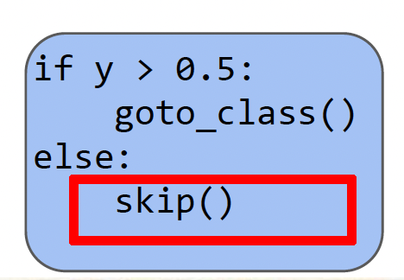
Introduction
Neural Networks
Applications
PyTorch
Summary
Building Neural Networks
Task: Predict if it worth going to class or not
a1
$$X= \left[\begin{aligned}difficulty of material \\ number of assignments due \\ days until midterm\end{aligned}\right]$$
$$Y=\left[probability of going to class\right]$$
A_1

Slide 18
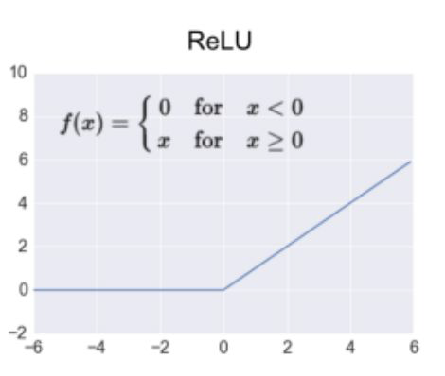
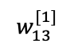

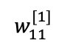
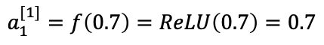
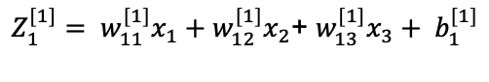
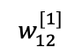
Introduction
Neural Networks
Applications
PyTorch
Summary
Building Neural Networks
Task: Predict if it worth going to class or not
0.7
$$w_{11}^{[1]}$$
0.4
$$w_{12}^{[1]}$$
$$X= \left[\begin{aligned}difficulty of material \\ number of assignments due \\ days until midterm\end{aligned}\right]$$
$$Y=\left[probability of going to class\right]$$
2
$$w_{13}^{[1]}$$
$Z_{1}^{[1]}= w_{11}^{[1]}x_{1}+w_{12}^{[1]}x_{2}$+ $w_{13}^{[1]}x_{3}+ b_{1}^{[1]}$
17
$=0.5 ∗0.4+0.1 ∗2+0.0058 ∗17+0.2=0.7$
$$a_{1}^{[1]}=f\left(0.7\right)=ReLU\left(0.7\right)=0.7$$
A_1

Slide 19
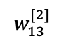
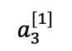
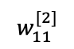
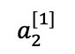
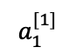
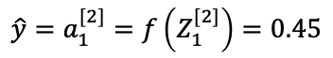
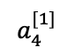
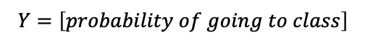
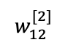
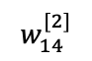
Introduction
Neural Networks
Applications
PyTorch
Summary
Building Neural Networks
$$a_{1}^{[1]}$$
Task: Predict if it worth going to class or not
0.7
$$w_{11}^{[2]}$$
0.4
$$a_{2}^{[1]}$$
0.2
$$w_{12}^{[2]}$$
0.45
$$X= \left[\begin{aligned}difficulty of material \\ number of assignments due \\ days until midterm\end{aligned}\right]$$
$$Y=\left[probability of going to class\right]$$
2
$$a_{3}^{[1]}$$
$$w_{13}^{[2]}$$
0.3
$Z_{1}^{[1]}= w_{11}^{[1]}x_{1}+w_{12}^{[1]}x_{2}$+ $w_{13}^{[1]}x_{3}+ b_{1}^{[1]}$
17
$$w_{14}^{[2]}$$
$=0.5 ∗0.4+0.1 ∗2+0.0058 ∗17+0.2=0.7$
$$a_{4}^{[1]}$$
$$a_{1}^{[1]}=f\left(0.7\right)=ReLU\left(0.7\right)=0.7$$
0.9
$Z_{1}^{[2]}= w_{11}^{[2]}a_{1}^{[1]}+w_{12}^{[2]}a_{2}^{[1]}$+ $w_{13}^{[2]}a_{3}^{[1]}+w_{14}^{[2]}a_{4}^{[1]}+b_{1}^{[2]}$
$${\hat{y}=a}_{1}^{[2]}=f\left(Z_{1}^{[2]}\right)=0.45$$
A_1

Slide 20
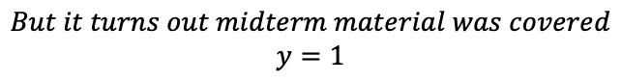
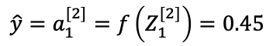
Introduction
Neural Networks
Applications
PyTorch
Summary
Building Neural Networks
$$a_{1}^{[1]}$$
Task: Predict if it worth going to class or not
0.7
$$w_{11}^{[2]}$$
0.4
$$a_{2}^{[1]}$$
0.2
$$w_{12}^{[2]}$$
0.45
$$X= \left[\begin{aligned}difficulty of material \\ number of assignments due \\ days until midterm\end{aligned}\right]$$
$$Y=\left[probability of going to class\right]$$
2
$$a_{3}^{[1]}$$
$$w_{13}^{[2]}$$
0.3
$${\hat{y}=a}_{1}^{[2]}=f\left(Z_{1}^{[2]}\right)=0.45$$
17
$$w_{14}^{[2]}$$
$$But it turns out midterm material was covered$$
$$y=1$$
$$a_{4}^{[1]}$$
0.9
A_1

Slide 21
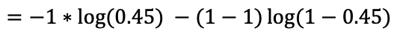
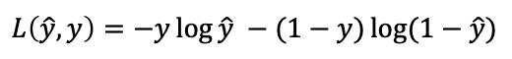
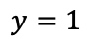
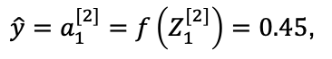
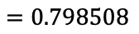
Introduction
Neural Networks
Applications
PyTorch
Summary
Building Neural Networks
$$a_{1}^{[1]}$$
Task: Predict if it worth going to class or not
0.7
$$w_{11}^{[2]}$$
0.4
$$a_{2}^{[1]}$$
0.2
$$w_{12}^{[2]}$$
0.45
$$X= \left[\begin{aligned}difficulty of material \\ number of assignments due \\ days until midterm\end{aligned}\right]$$
$$Y=\left[probability of going to class\right]$$
2
$$a_{3}^{[1]}$$
$$w_{13}^{[2]}$$
0.3
${\hat{y}=a}_{1}^{[2]}=f\left(Z_{1}^{[2]}\right)=0.45$,
$$y=1$$
17
$$w_{14}^{[2]}$$
$$L\left(\hat{y}, y\right)=−y\log{\hat{y} −(1−y)\log{(1−\hat{y})}}$$
$$a_{4}^{[1]}$$
$$=−1∗\log{(0.45) −(1−1)\log{(1−0.45)}}$$
0.9
$$=0.798508$$
Binary Cross Entropy
A_1

Slide 22
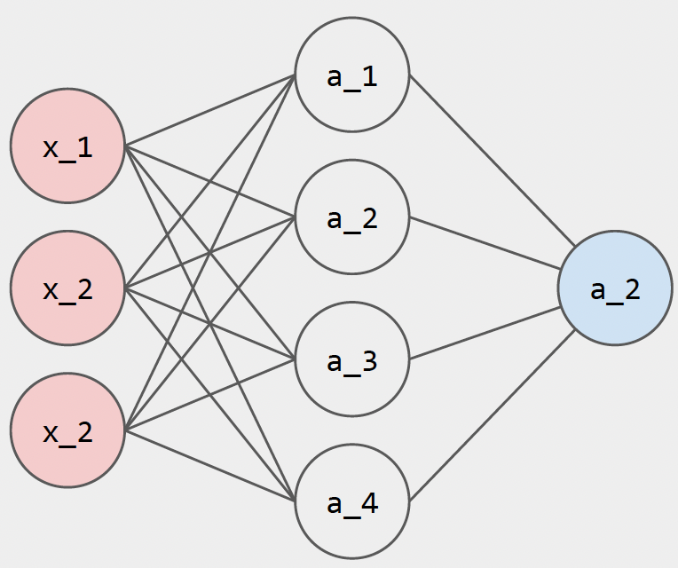
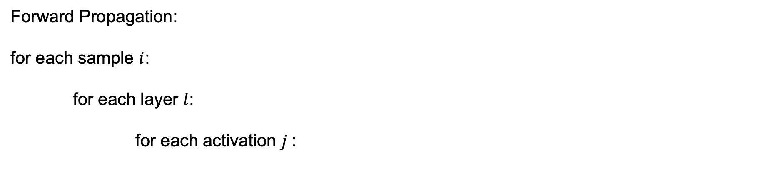
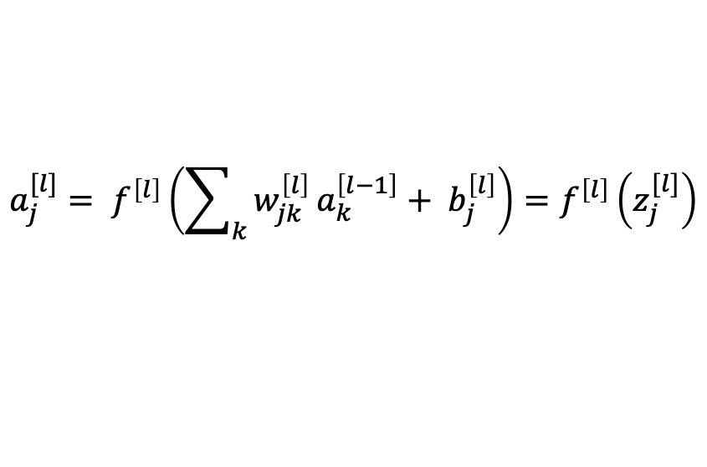
Introduction
Neural Networks
Applications
PyTorch
Summary
Neural Networks
Forward Propagation:
for each sample $i$:
for each layer $l$:
for each activation $j$:
$$a_{j}^{[l]}= f^{\left[l\right]}\left(\sum_{k}{w_{jk}^{\left[l\right]}}a_{k}^{\left[l−1\right]}+ b_{j}^{\left[l\right]}\right)=f^{\left[l\right]}\left(z_{j}^{[l]}\right)$$

Slide 23
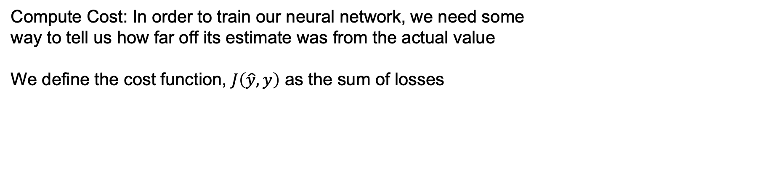
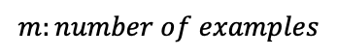
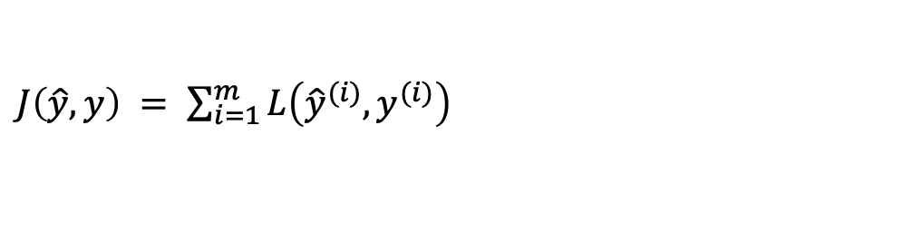
Introduction
Neural Networks
Applications
PyTorch
Summary
Neural Networks
Compute Cost: In order to train our neural network, we need some
way to tell us how far off its estimate was from the actual value
We define the cost function, $J\left(\hat{y}, y\right)$ as the sum of losses
$J\left(\hat{y}, y\right) = \sum_{i=1}^{m}{L\left({\hat{y}}^{(i)}, y^{(i)}\right)}$
$$m:number of examples$$
$$J\left(θ\right) =Cost Function$$
Loss = Error for a single training example
Cost = Sum of all losses

Slide 24
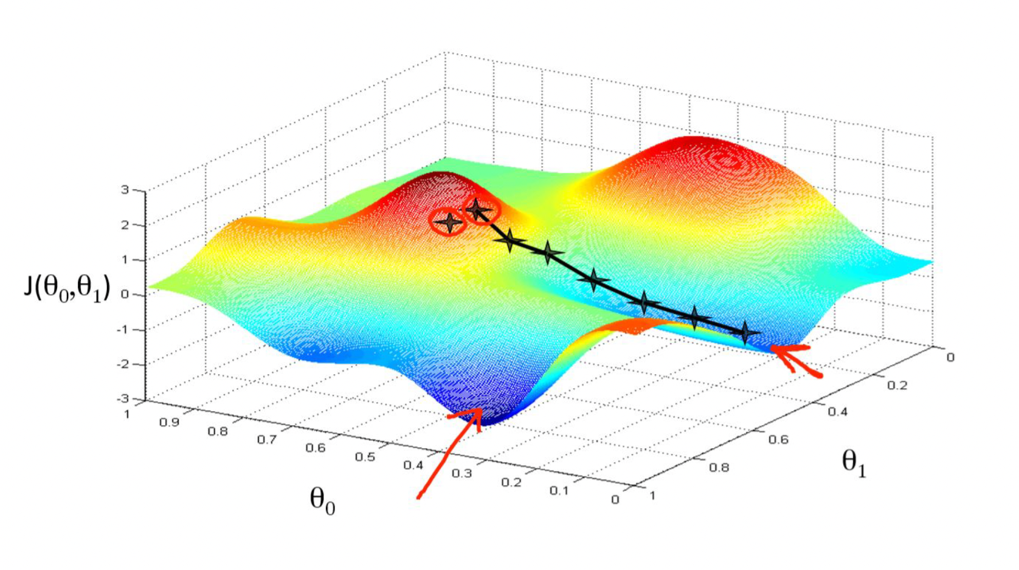
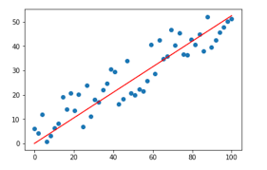
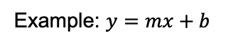
Introduction
Neural Networks
Applications
PyTorch
Summary
Neural Networks
Train with gradient descent
Example: $y=mx+b$

Slide 25
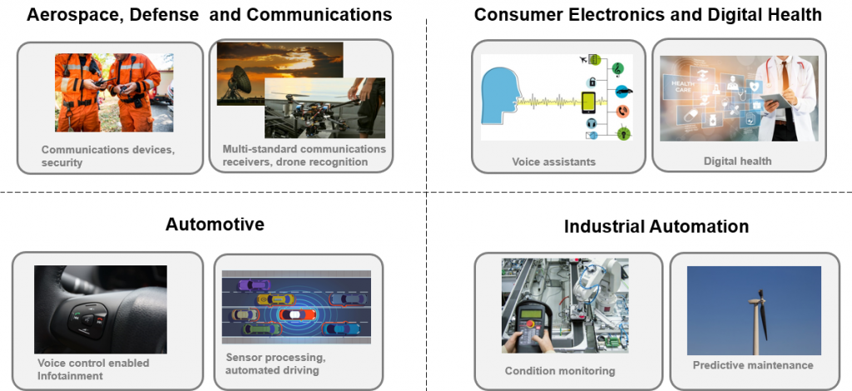
Introduction
Neural Networks
Applications
PyTorch
Summary
Deep Learning Applications

Slide 26
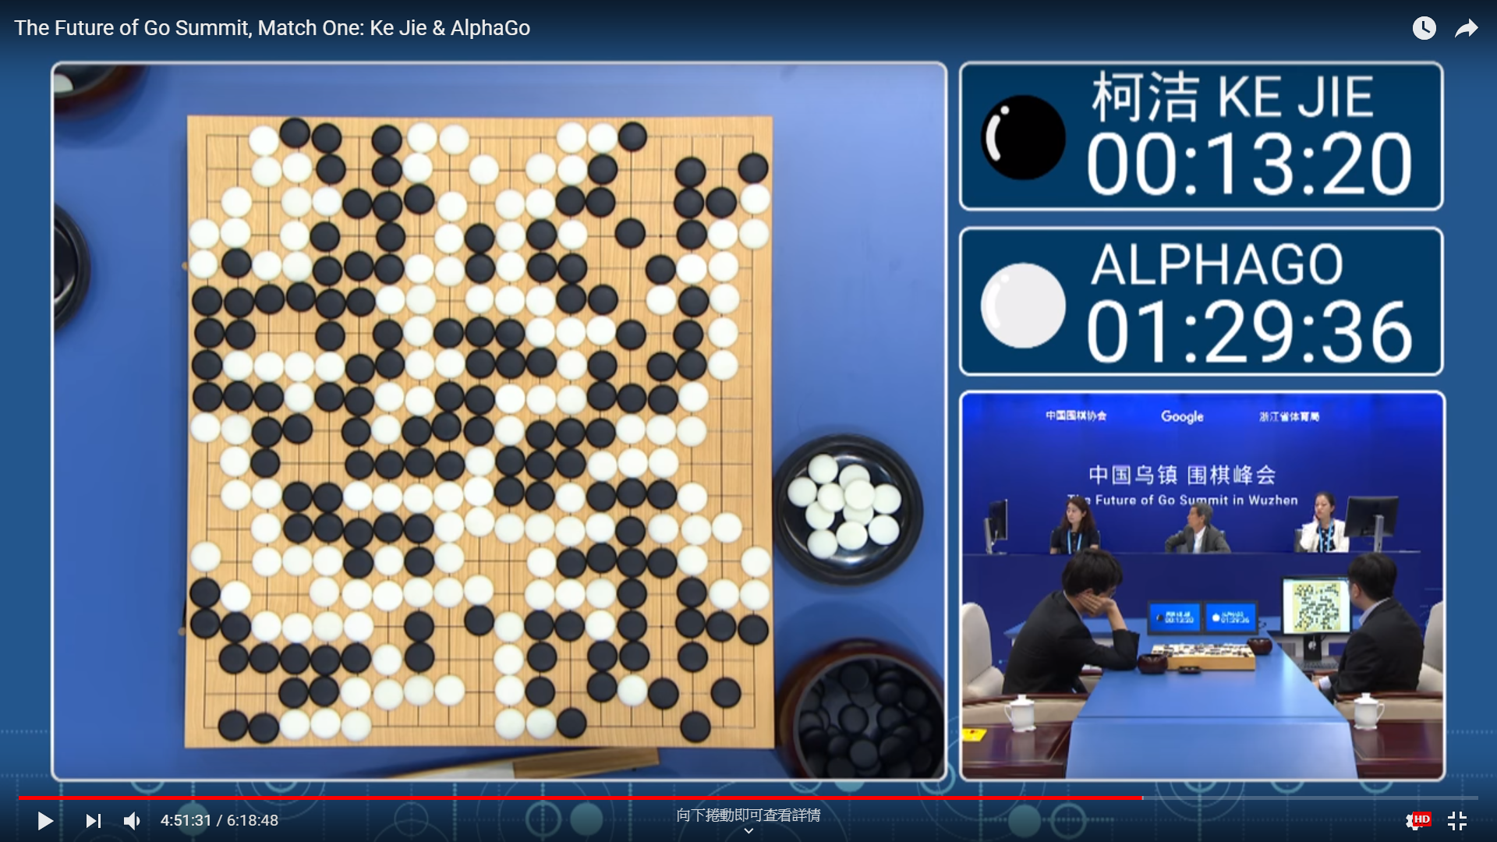
Introduction
Neural Networks
Applications
PyTorch
Summary
Deep Learning Applications

Slide 27
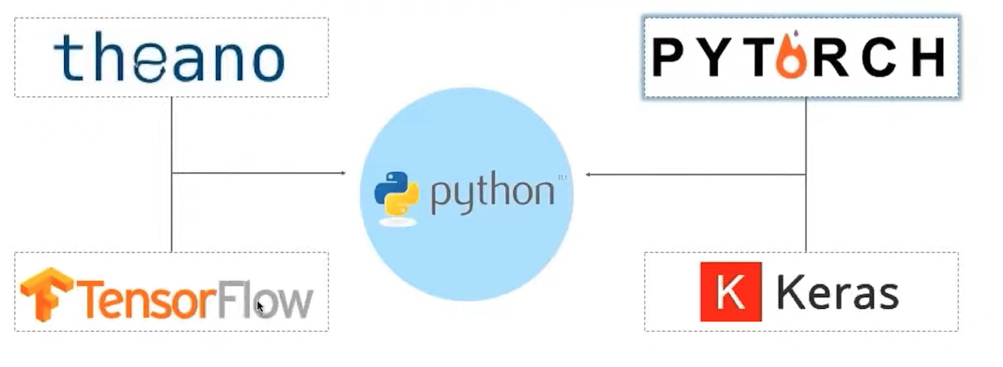
Introduction
Neural Networks
Applications
PyTorch
Summary
Neural Networks Packages

Slide 28
Introduction
Neural Networks
Applications
PyTorch
Summary
Pytorch Tutorial
Machine Learning Workflows
Working with Data
Creating models
Optimizing model parameters
Saving the trained models

Slide 29
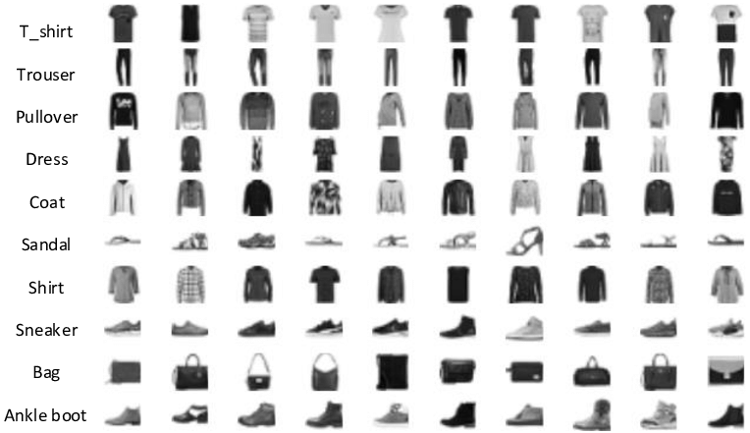
Introduction
Neural Networks
Applications
PyTorch
Summary
Pytorch Tutorial
Predict if an input image belongs to one of the following classes: T-shirt/top, Trouser, Pullover, Dress, Coat, Sandal, Shirt, Sneaker, Bag, or Angle boot.
FasionMNIST Dataset

Slide 30
Introduction
Neural Networks
Applications
PyTorch
Summary
Pytorch Tutorial: Working with Data
Dataset: stores the samples and their corresponding labels TorchText, TorchVision, and TorchAudio
torchvision.datasets: CIFAR, COCO, FashionMNIST
transform and target_transform to modify the samples and lables respectively
PyTorch
DataLoader: wraps an iterable around the Dataset

Slide 31
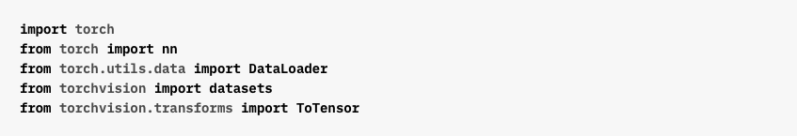

Introduction
Neural Networks
Applications
PyTorch
Summary
Working with Data
Importing Modules
Define Training and Test Dataset

Slide 32

Introduction
Neural Networks
Applications
PyTorch
Summary
Working with Data
Pass the Dataset as an argument to DataLoader
Wraps an iterable over dataset and supports automatic batching, sampling, shuffling and multiprocess data loading
Define DataLoader

Slide 33

Introduction
Neural Networks
Applications
PyTorch
Summary
Creating Models
Check if GPU is Available
Create Neural Networks Model

Slide 34
Introduction
Neural Networks
Applications
PyTorch
Summary
Optimizing the Model Parameters

Slide 35

Introduction
Neural Networks
Applications
PyTorch
Summary
Define Training Loop

Slide 36

Introduction
Neural Networks
Applications
PyTorch
Summary
Define Test Dataset

Slide 37

Introduction
Neural Networks
Applications
PyTorch
Summary
Training Loop

Slide 38
Introduction
Neural Networks
Applications
PyTorch
Summary
Saving Models

Slide 39
Introduction
Neural Networks
Applications
PyTorch
Summary
Loading Models

Slide 40

Introduction
Neural Networks
Applications
PyTorch
Summary
Make Predictions

Slide 41

Introduction
Neural Networks
Applications
PyTorch
Summary
Summary

